Slide 2
The GRB Rate
Intro Swift Catalog Trigger Simulation GRB rate Summary
Lien et al. (2014)
SFR shape from
Yuksel et al. (2008)
SFR shape from
Hopkins & Beacom (2006)
Lien et al. (2014)
Notes:
2 min
Tot 43
Talk about we need more dim bursts
The complex trigger algorithm is more sensitive than single threshold → need bursts to be dimmer otherwise it will be triggered.
Make it into animation, show three curve step-by-step.

Slide 3
The GRB Rate
Intro Swift Catalog Trigger Simulation GRB rate Summary
Possibilities:
Higher star-formation rate in the early universe
The ratio of GRB/SN evolves (e.g., Woosley & Heger 2012)
Luminosity evolution (e.g., Virgili et al. 2011)
This Work
SFR shape from
Yuksel et al. (2008)
SFR shape from
Hopkins & Beacom (2006)
Lien et al. (2014)
Notes:
25:00
Talk about we need more dim bursts
The complex trigger algorithm is more sensitive than single threshold → need bursts to be dimmer otherwise it will be triggered.
Make it into animation, show three curve step-by-step.

Slide 4
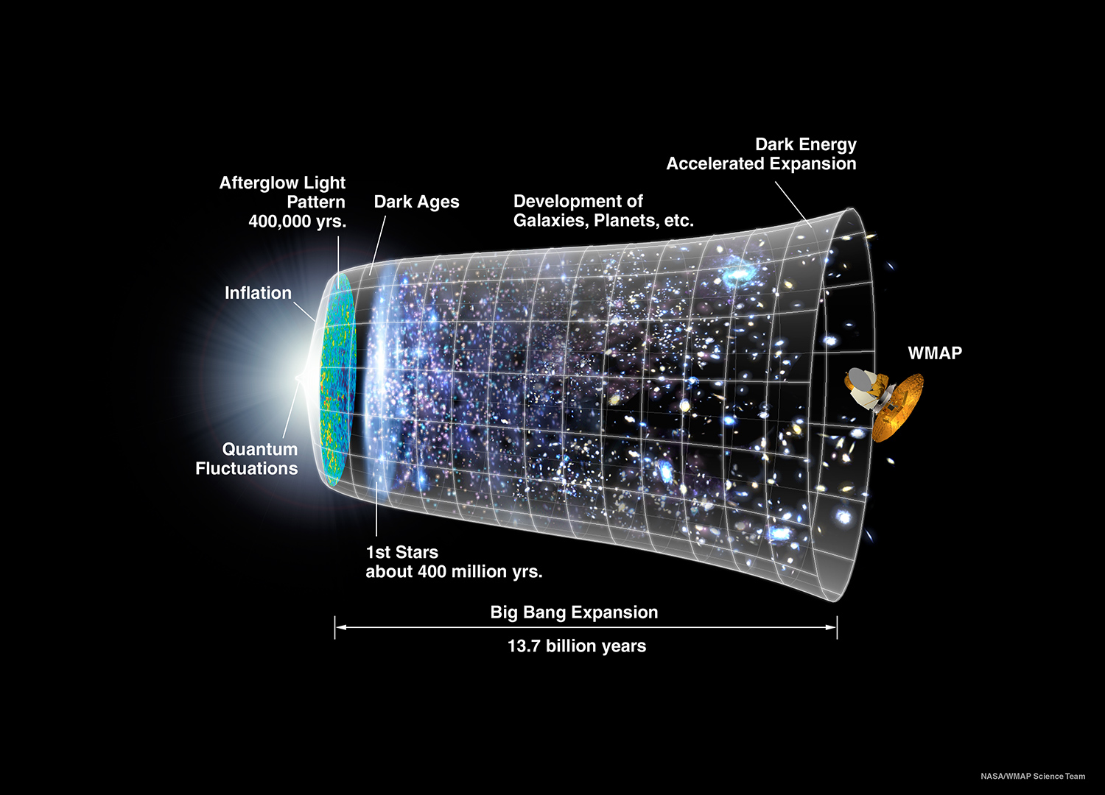
GRB090423 (z=8.2; 640 million years; Tanvir et al. 2009; Salvaterra et al. 2009)
Notes:
Tot 4:30

Slide 5
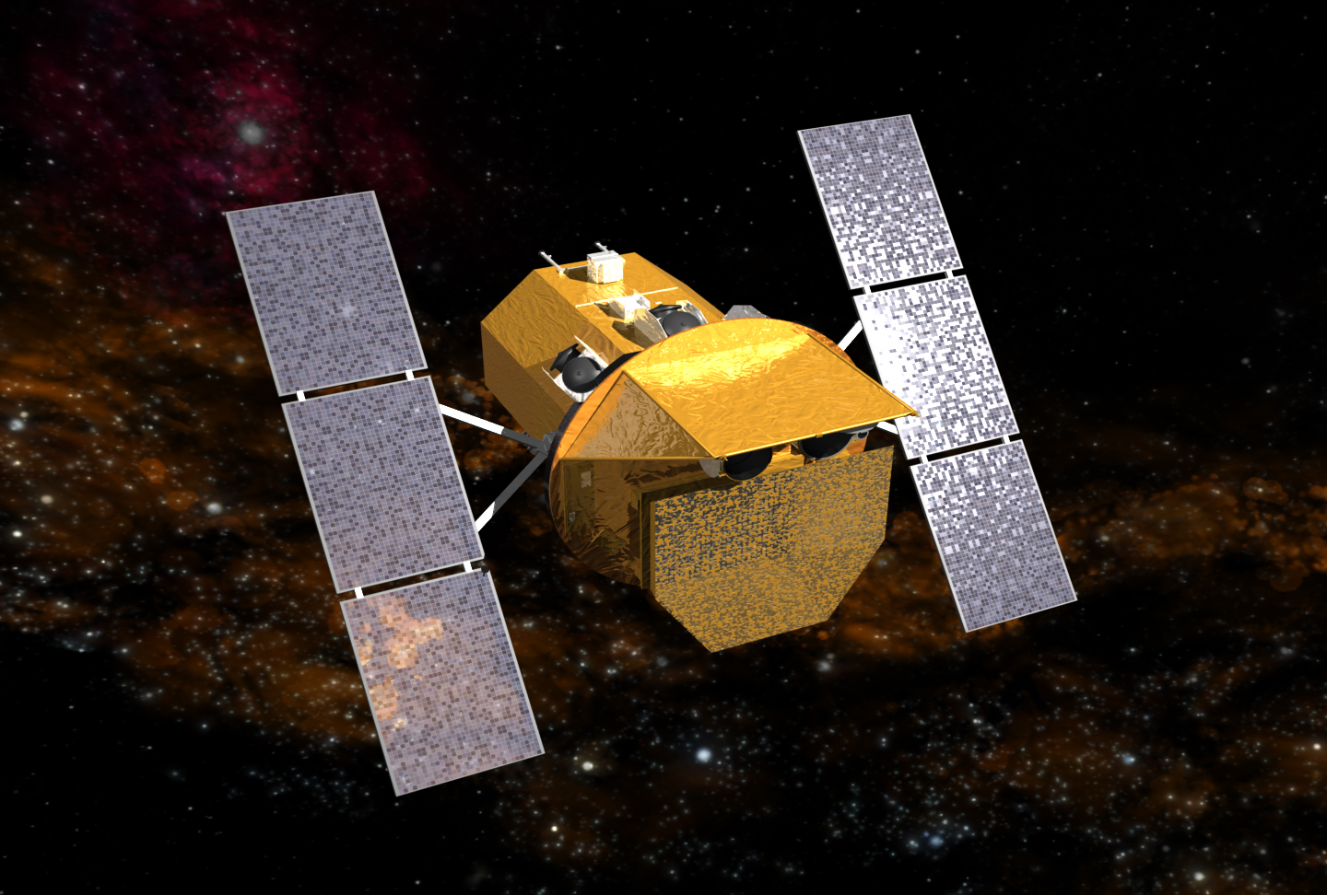
Intro Swift BAT GRBs Gravitational Waves Summary
Neil Gehrels Swift Observatory
UV/Optical Telescope (UVOT)
X-Ray Telescope (XRT)
Burst Alert Telescope (BAT)
Gehrels et al. (2004)
Notes:
1:30 min

Slide 6
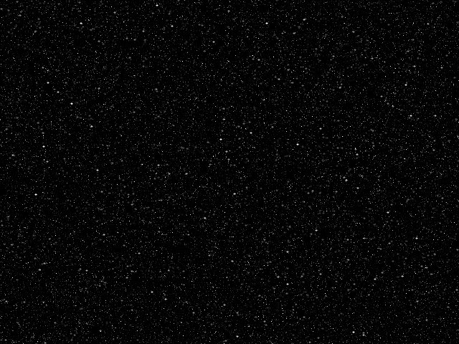
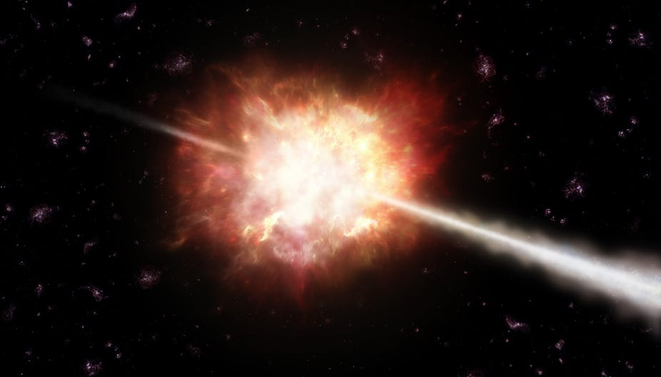
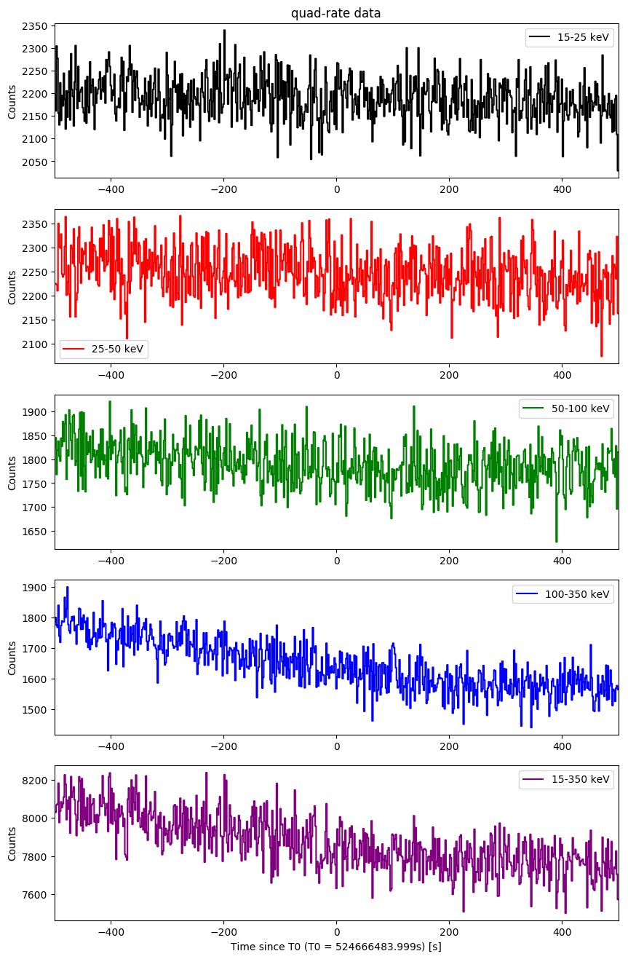

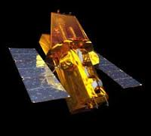
Intro Swift BAT GRBs Gravitational Waves Summary
GW170817
Earth
Swift/BAT light curves
LIGO
Swift/BAT
130 million light years
Fermi/GBM
Notes:
1 min
Tot: 43 min

Slide 7
Short-hard vs long-soft?
Intro Swift Catalog Trigger Simulation GRB rate Summary
Lien et al. (2016)
Hardness Ratio
Short-hard GRBs
Long-Soft GRBs
Burst Duration
Notes:
1 min
Tot 29:30

Slide 8
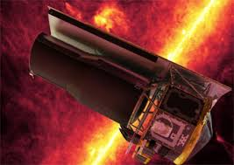
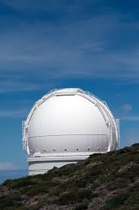

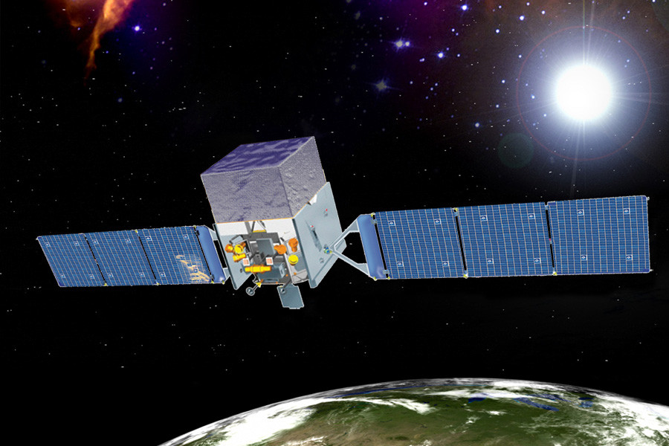
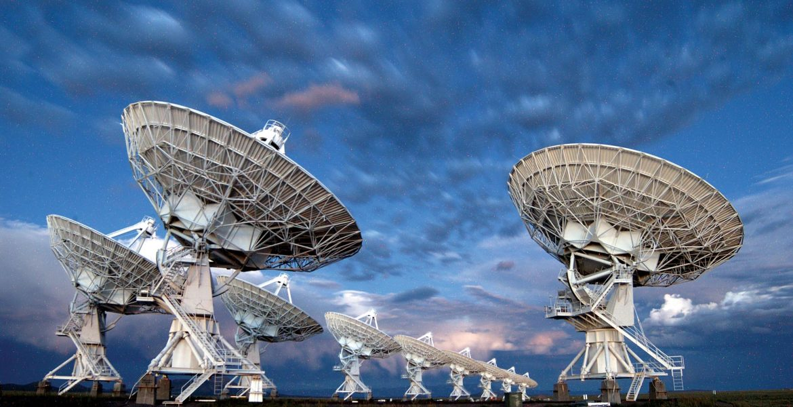
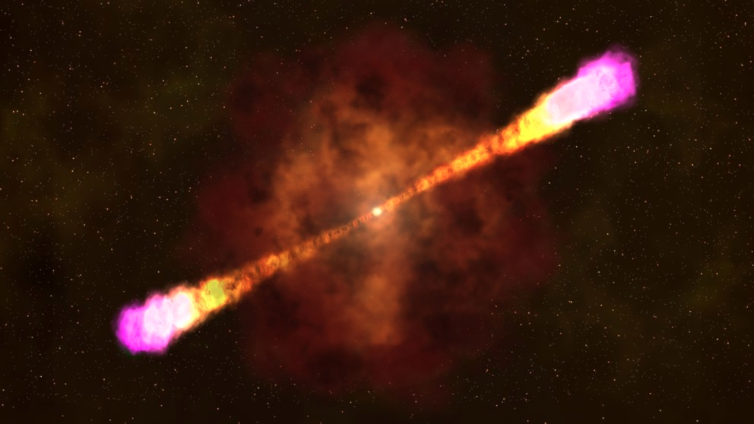
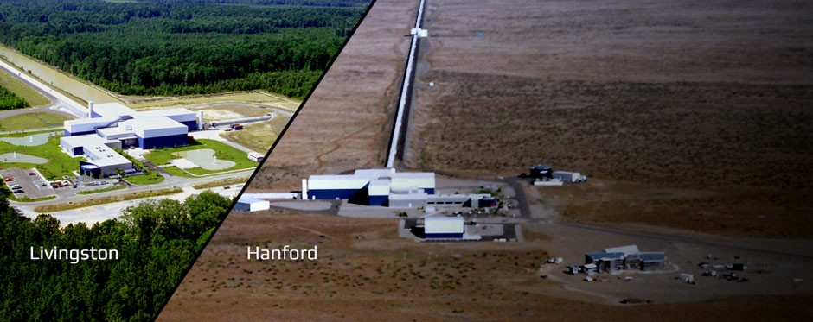
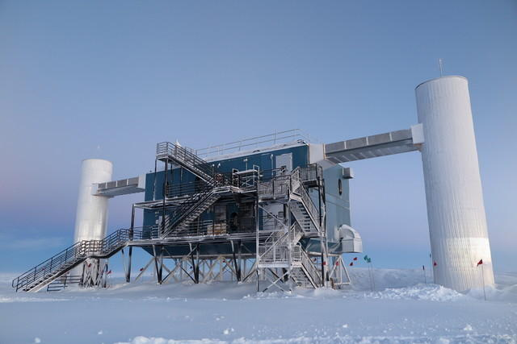
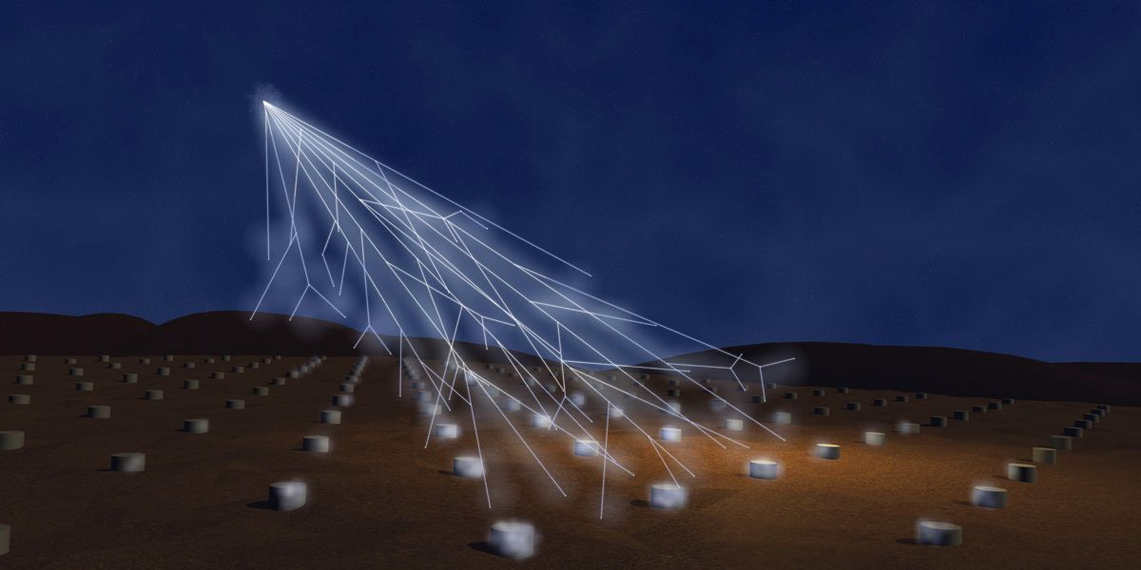
GRBs and their multi-messenger nature
Intro GRB observatories GRB properties GRB origins Summary
Infrared
(IR)
Ultraviolet
(UV)
X rays
Gamma rays
Radio
Visible
(Optical)
VLA
Swift
Hubble
Gravitational waves
Neutrinos
Cosmic rays
Notes:
30 s
Tot: 18:00

